Slide 1

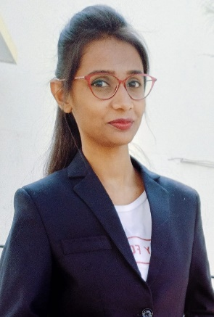
Shrushti Kolhe
Education and certificates Bachelor of Engineering Computer Engineering : 2016 -
2020
Certificates
MuleSoft Certified Developer Level -1
Agile Methodology certificate
AWS Level 0 Certificate
Analyst/Software Engineer
Base Location: Pune
Email ID: shrushti-pramod.kolhe@capgemini.com
Mobile No: +91 9130474299
Grade: A4
Skills
Mule 4
Agile Development
JSON, XML
Software Testing
Competencies
Basic understanding on Integration Principles and Design Patterns.
Ability to design using AnyPoint Platform to build, deploy, manage, and govern APIs.
Good knowledge on MuleSoft Integration Best Practices
Integration Experience
Worked as a shadow resource in KPMG project.
Designed and developed RAML based API using Anypoint platform and imported the RAML to Anypoint Studio to build the Mule Application
Used Dataweave transformations to transform message to target formats like JSON, XML, CSV, etc. and have worked on various operators like map, pluck, Arrays, lookup and filter.
Database
SQL database - MySQL, PostgreSQL
Web Technologies HTML5
CSS3
JavaScript AddOns Postman
Github
Has Good understanding on Agile methodology.
Hands on experience in building API-led and Connector- based integrations.
Used Database and HTTP connectors to implement API methods to fetch data from database.
Have basic knowledge on Web Technologies – HTML,
CSS, JavaScript.
Good knowledge of Testing Concepts, SDLC and STLC.
Practical knowledge in deploying application to Anypoint Cloud Hub.
Implemented basic Mule flows using Scopes, Error handling Strategies, Validation, Flow controls, Transformations.
Additional Details
Excellent Communication Skills
Team Player
Mule Specifies
RAML, Exchange, Standard connectors, API Manager, Runtime Manager, Access Management, Dataweave, Scheduler, Exception handling, Logging, MUnit, Monitoring
/
Presentation Title | Author | Date © Capgemini 2017. All rights reserved |

